Slide 1

DRIVE SAFE WITH AI ASSISTANCE
Group No.16
Umesh Nehete 22207001 Vineet Mhatre 22207009
Priyanshu Worlikar 22207001
Aditi Yadav 21107018
Project Guide.
Prof. Poonam Pangarkar
Prof. Harsha Zope

Slide 2
Contents
Abstract
Introduction
Objectives
Literature Review
Research Gap
Problem Definition
Scope
Technological Stack
Proposed System Architecture/Working
Prototype Design Demonstration
Implementation Status
Review Suggestions (Given in Last meeting)

Slide 3
Abstract
The project develops a comprehensive road safety system to reduce traffic accidents and enhance driving safety. Key features include Driver Drowsiness Detection using video processing and facial landmarks for alerts, and an AI-powered alert system employing machine learning and natural language processing for real-time voice-activated warnings. It also includes Collision Detection through real-time video processing and convolutional neural networks (CNN) to identify potential crashes quickly, alongside Pothole Detection to prevent accidents. Additionally, Power BI is utilized to analyze and visualize driver behavior and safety system performance, focusing on drowsiness, collisions, and lane-keeping events.

Slide 4
Introduction
1.Road safety remains a critical global concern as traffic accidents continue to result in significant loss of life and property.
2. The integration of advanced technologies presents an opportunity to mitigate risks and enhance driving safety.
3. This project aims to develop a comprehensive road safety system that incorporates three key technologies: Driver Drowsiness Detection, Collision Detection, and Pothole Detection.
Combining all these elements into a unified platform, the system is designed to address multiple factors that contribute to road accidents, creating a safer driving environment.

Slide 5
Motivation:
Unified road safety system integrating Driver Drowsiness Detection, Collision Detection, and Pothole Detection technologies.
The system enhances driver awareness, prevents collisions, and mitigates road hazards by addressing key factors contributing to traffic accidents. The ultimate goal is to significantly reduce traffic- related injuries and fatalities, promoting safer driving environments.

Slide 6
Objectives
To detect driver drowsiness, lane switching, potholes and providing alerts before potential accidents occurs using CNN, AAQI, OpenCV.
To detect collision, alert emergency services about accidents, and make a record of the incident using CNN, Geospatial AI, GIS Integration, OpenCV,.
To develop a voice assistant that provides real-time safety alerts and notifications for drivers based on detected condition of drowsiness , pothole ,collision using NLP .
To analyze driver behavior and safety system performance using Power BI by visualizing data related to drowsiness detection, pothole and collision incidents.

Slide 7
Literature Review
Sr.no | Title | Author(s) | Year | Methodology | Drawback
1 | Driver Drowsiness Detection Using Machine Learning Algorithm | Prasath N Sreemathy J Vigneshwaran P | 2022 | Machine learning model that uses features such as eye movement, blinking patterns, and yawning detection to monitor and predict driver drowsiness, ultimately issuing real-time alerts to prevent accidents. | 1. reliance on expensive equipment like electrocardiography, and potential inaccuracies in detecting eye regions using support vector machine.
2 | Driver Drowsiness Detection System Using Deep Neural Network. | Dr. Jagannath E. Nalavade Rutuja Sanjay Patil | 2023 | A deep neural network with facial landmarks and an eye aspect ratio (EAR) to monitor eye closure and detect drowsiness in real-time. Triggering alerts when necessary | 1. Faces challenges with lighting conditions, detecting faces with glasses or facial variations,

Slide 8
Literature Review
Sr.no | Title | Author(s) | Year | Methodology | Drawback
3 | Driver Drowsiness Detection and Alert System | R Kannan Palamakula Jahnavi M Megha | 2023 | Detects driver drowsiness by using a camera to monitor facial features and eye closure through the Eye Aspect Ratio (EAR) algorithm. Trriggering an alarm when prolonged eye closure is detected, with continuous tracking supported by a ResNet deep neural network​. | 1. Detecting when the driver's face is turned away, and may still be considered intrusive despite aiming to be non-intrusive.
4 | Pothole detection system. | Vineet Kaushik Birinderjit Singh Kalyan | 2022 | capturing images or videos using a digital camera mounted on a vehicle Grayscale conversion, segmentation, and morphological filtering, and then applying spectral clustering and histogram-based methods . | high costs in 3D reconstruction, inaccuracy in vibration-based methods limitations in 2D imaging for depth assessment, and noise interference in vision-based techniques.

Slide 9
Literature Review
Sr.no | Title | Author(s) | Year | Methodology | Drawback
5 | Intelligent Voice Assistant by Using OpenCV Approach | Vijaya Chandra Jadala VSRK Sarma | 2024 | The system captures and processes voice commands from users to ensure safe driving. It helps the system interpret safety-related commands. The system is tested for accuracy in different driving conditions | Incorrect interpretations in noisy environments can lead to errors. Voice commands may distract drivers, especially if repeated. Variations in speech can reduce recognition accuracy.
6 | Artificial Intelligence based Vision and Voice Assistant | Logesh V Sai Dinesh R S | 2024 | Develop a hands-free interaction system for vehicles using computer vision. Use computer vision to recognize driver gestures and monitor attention. Test with drivers to evaluate the effectiveness of voice commands and gesture recognition. | Technical issues, like software bugs or hardware failures, could impair functionality. Interacting with the system, even through voice, may still divert attention from the road. Voice commands may be misinterpreted, especially in noisy environments like traffic.

Slide 10
Literature Review
Sr.no | Title | Author(s) | Year | Methodology | Drawback
7 | Enhanced AI voice assistance using ML | J Gowthamy Aakash S | 2024 | Use speech recognition and NLP to interpret navigation and safety commands accurately Enhance command recognition over time based on user interactions. | Voice commands may be misinterpreted, especially in noisy environments like traffic Even voice interactions can divert attention from the road, especially if repeated commands are needed
8 | A Real-Time Collision Detection System for Vehicles | Sam Amiri Shailendra Singh | 2021 | Normalize images and split the dataset into training, validation, and test sets. Train the model using the annotated dataset, optimizing for accuracy and relevant loss functions. Integrate the trained model into a system that processes video feeds for collision detection. | Quality and diversity of training data can impact accuracy. Balancing speed and accuracy can be difficult.

Slide 11
Literature Review
Sr.no | Title | Author(s) | Year | Methodology | Drawback
9 | Vehicle Detection and Collision Avoidance System | Catherine Philip D. Veera Vanith K Keerthi | 2022 | Analyze existing research on vehicle collision detection and avoidance systems. Assess each approach's accuracy, response time, and adaptability | Performance can degrade in adverse weather and low-light conditions. Advanced sensors and technologies (like LiDAR) can be expensive, increasing vehicle costs.
10 | Intelligent Vehicle Collision Detection and Traffic Control | S. Sneha K. Deepa M. Nithya | 2022 | Continuously monitor sensor data during operation Use a GPS module for location tracking Analyse incident data for future improvement | Sensors may have limitations in adverse weather conditions affecting accuracy Over-reliance on automated systems may lead to reduced driver attention and vigilance.

Slide 12
Literature Review
Sr.no | Title | Author(s) | Year | Methodology | Drawback
11 | Deep learning applied to road accidents with transfer learning and synthesis images. | Tiago Tamaguskoa Anh Huynhb, Adelino Ferreiraa | 2022 | The methodology of the project involves using a Convolutional Neural Network (CNN) to analyze image frames from dash cam. footage detects car crashes, followed by testing the performance using machine learning algorithms, including Logistic Regression and Random Forest, for comparative analysis based on accuracy, sensitivity. | One limitation of the car crash detection project using machine learning and deep learning algorithms is the moderate accuracy and recall rates of the Convolutional Neural Network (CNN) model, which may lead to missed or incorrect detections in real-time applications
12 | Car Crash Detection System using Machine Learning and Deep Learning Algorithms | Supriya M S Himanshu jain Sahana P Shankar | 2022 | The methodology used in the project involves using Convolutional Neural Networks (CNNs) to classify images from dash cameras into accident and non-accident categories, with comparative analysis between Random Forest and Logistic Regression algorithms to predict crash severity and location. | One limitation of the project "Deep Learning applied to Road Accident Detection with Transfer Learning and Synthetic Images" is the reliance on synthetic images due to the lack of real accident data, which may affect the model's performance in real-world scenarios.

Slide 13
Research Gap(Limitations of existing systems)
Listed projects realize that sensors, synthetic data, and the moderate accuracy of machine learning algorithms may hinder real-world performance in adverse conditions, leading to incorrect or missed detections.
Existing drowsiness detection projects face challenges with accuracy in diverse conditions (e.g., lighting, weather) and reliance on visual cues, which may not work for all individuals or scenarios. They also suffer from high computational demands, sensor limitations, and privacy concerns related to continuous monitoring.
Collision Detection systems face challenges with accuracy in adverse weather, limited real-world data, and the risk of false positives or missed detections.
Pothole Detection struggles with false positives, sensor limitations, and ineffective detection in remote areas or at higher speeds.

Slide 14
Problem Definition
Road accidents remain a leading cause of injuries and fatalities worldwide, primarily due to factors such as driver fatigue, collisions, and hazardous road conditions like potholes. Traditional methods of mitigating these risks are often reactive or insufficient, leaving drivers vulnerable to accidents caused by drowsiness, lack of awareness, and poorly maintained roads. There is a critical need for an integrated technological solution to proactively detect and address these issues in real-time, ensuring a safer driving experience and reducing traffic-related accidents and fatalities.

Slide 15
Scope
Driver Drowsiness Detection: Implement a system that monitors driver alertness, alerts the driver to potential drowsiness, and provides recommendations for rest stops.
Collision Detection: Develop technology to detect potential collisions, automatically
notify emergency contacts, and record collision data for further analysis.
Pothole Detection: Create a system that detects potholes and road defects in real time, and provides immediate alerts to drivers to avoid hazards.

Slide 16
Technological Stack
▶ Python version 3.10.2 CNN Algorithm OpenCV
▶ AAQI
▶ Geospatial
▶ NLP
▶ Tensorflow 2.14.0
▶ Keras 2.14.0
▶ CNN

Slide 17
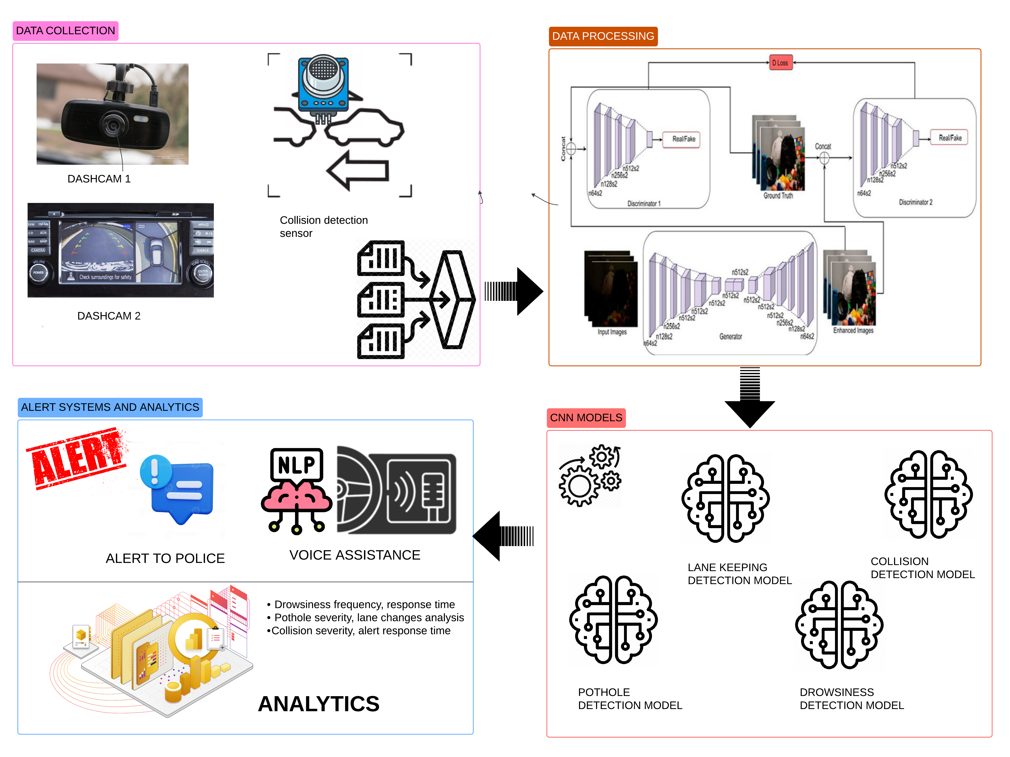
Architechure diagram

Slide 18
References
[1] Dinesh, RS Sai, et al. "Artificial Intelligence based Vision and Voice Assistant[5]." 2022 International Conference on Electronics and Renewable Systems (ICEARS). IEEE, 2022. Vijaya Chandra Jadala, VSRK Sarma, Intelligent Voice Assistant by Using OpenCV Approach, 2024.
[2] Gowthamy, J., et al. "Enhanced AI Voice Assistance using Machine Learning and NLP.[7]" 2023 Third International Conference on Smart Technologies, Communication and Robotics (STCR). Vol. 1. IEEE, 2023.
[3] Nalavade, Jagannath E., and Rutuja Sanjay Patil. "Driver Drowsiness Detection System Using Deep Neural Network." 2022 3rd International Conference on Computing, Analytics and Networks (ICAN). IEEE, 2022.
[4] R Kannan Palamakula Jahnavi M Megha, Driver Drowsiness Detection and Alert System, 2023.
[5] Prasath, N., J. Sreemathy, and P. Vigneshwaran. "Driver drowsiness detection using machine learning algorithm." 2022 8th International conference on advanced computing and communication systems (ICACCS). Vol. 1. IEEE, 2022.

Slide 19
References
[6] Kaushik, Vineet, and Birinderjit Singh Kalyan. "Pothole detection system: A review of different methods used for detection." 2022 Second International Conference on Computer Science, Engineering and Applications (ICCSEA). IEEE, 2022.
[7] Philip, Catherine, D. Veera Vanitha, and K. Keerthi. "Vehicle detection and collision avoidance system." 2022 8th international conference on advanced computing and communication systems (ICACCS). Vol. 1. IEEE, 2022.
[8] Sneha, S., K. Deepa, and M. Nithya. "Intelligent Vehicle Collision Detection and Traffic Control." 2022 International Conference on Innovations in Science and Technology for Sustainable Development (ICISTSD). IEEE, 2022.
[9] Tiago Tamaguskoa, Anh Huynhb, Adelino Ferreiraa, Deep learning applied to road accidents with transfer learning and synthesis images, 2022.
[10] Supriya, M. S., et al. "Car crash detection system using machine learning and deep learning algorithm." 2022 IEEE International Conference on Data Science and Information System (ICDSIS). IEEE, 2022.
Drive link

Slide 20
Thank You...!!

